Slide 1
Outline
Brief introduction to testbed topology
Some studies about BGP
Minimum requirement for testbed

Slide 2
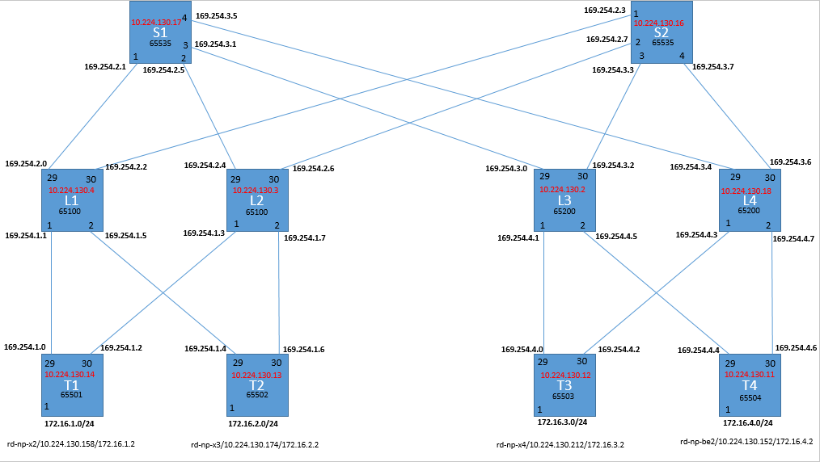
Testbed topology: ideal
AS ID: 65535
AS ID: 65100
AS ID: 65200
AS ID: 65501
AS ID: 65502
AS ID: 65503
AS ID: 65504

Slide 3
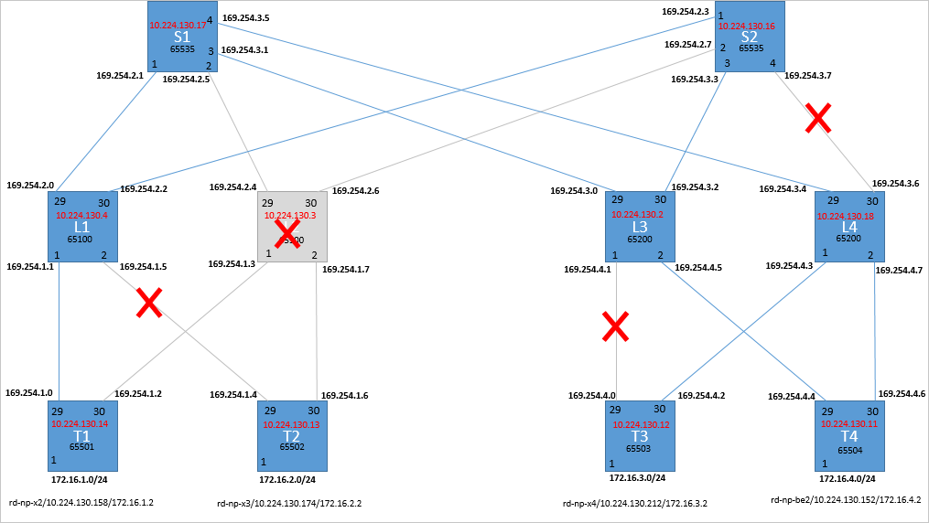
Testbed topology: reconfigured

Slide 4
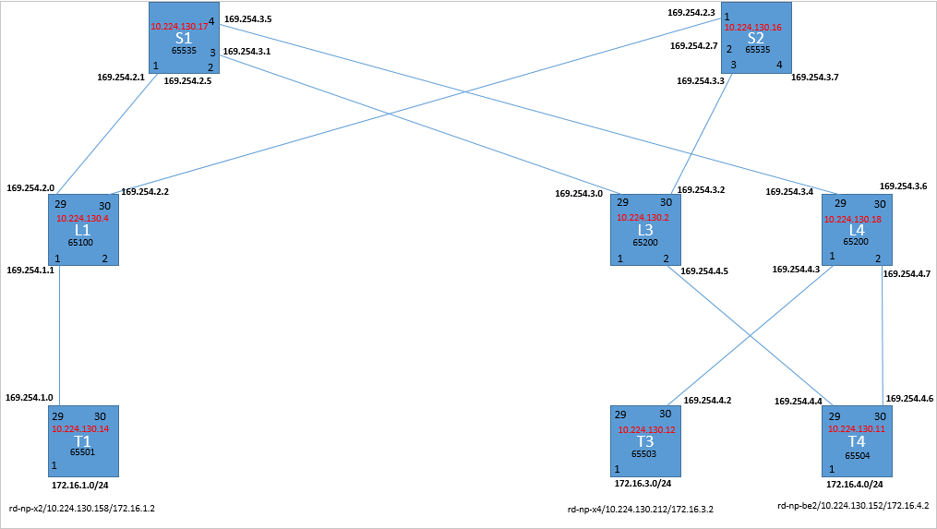
Testbed topology: reconfigured

Slide 5
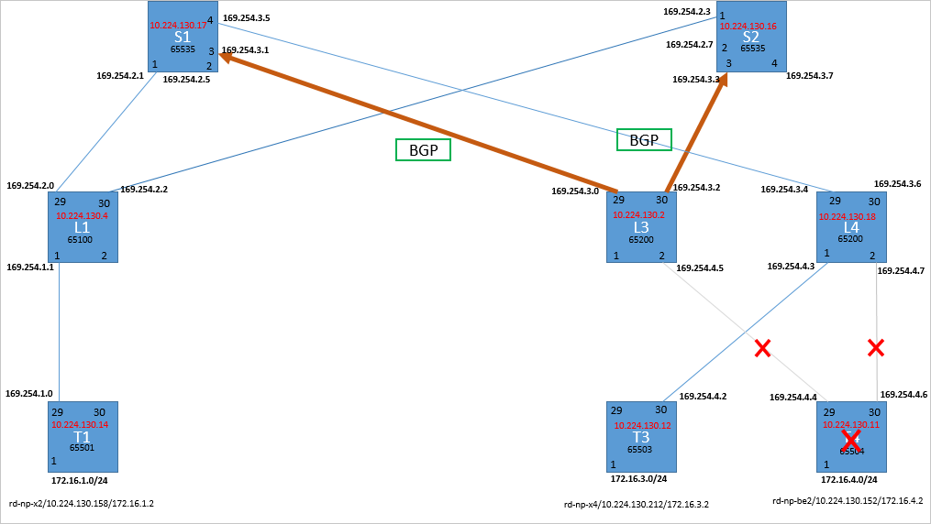
BGP study: switch processing time of BGP UPDATE
Time to send BGP UPDATE messages to neighbors after detecting link failures: not measured.
Time to process BGP UPDATE messages received from neighbors: about 1ms.

Slide 6
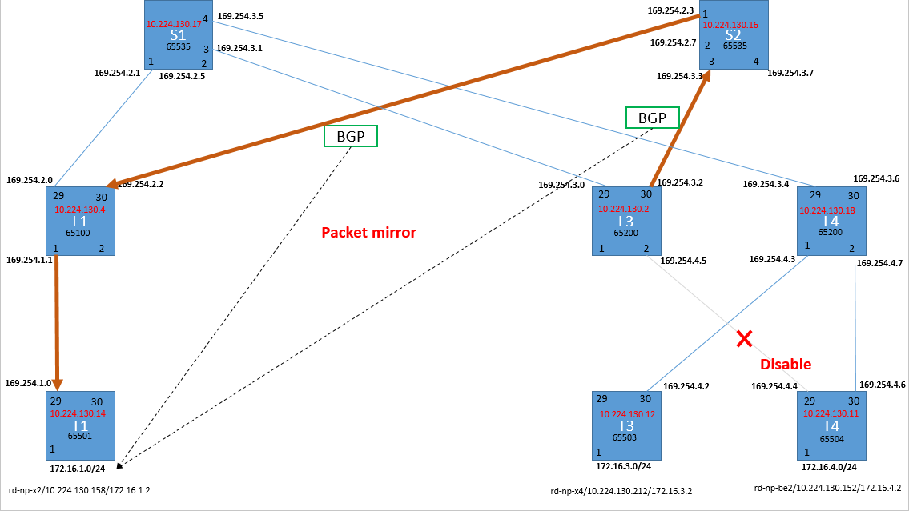
Measurement of switch processing time of BGP UPDATE
t2
t1
t2 – t1 is an estimation of switch processing time of BGP UPDATE messages.

Slide 7
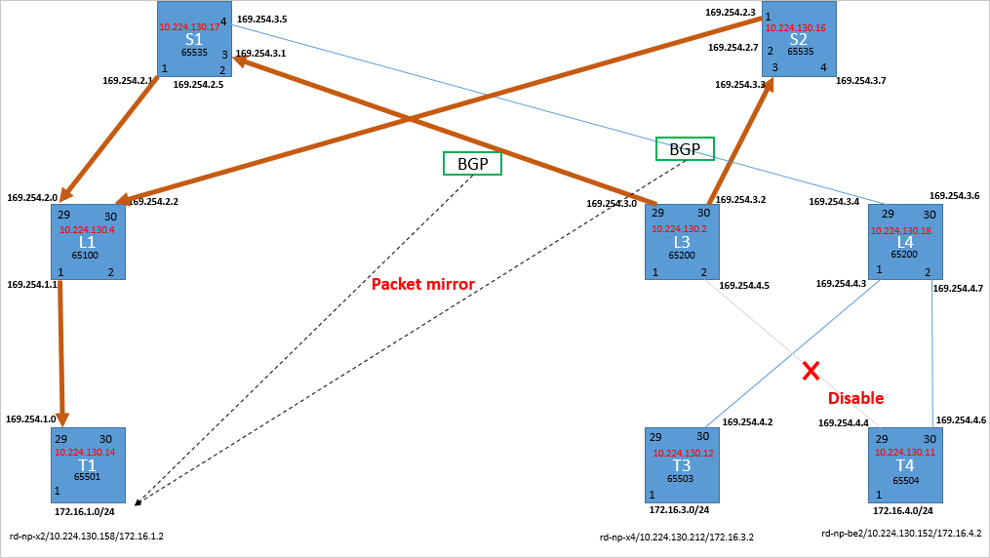
Measurement of switch processing time of BGP UPDATE
t1’
t1
t1’ ≈ t1

Slide 8
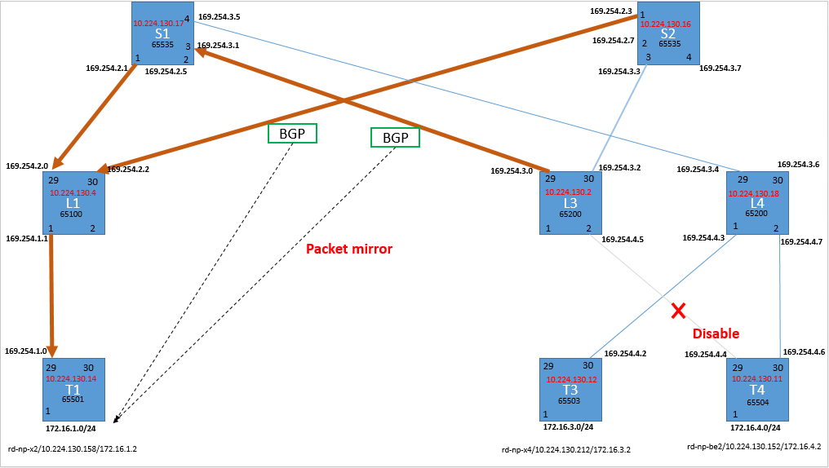
Measurement of switch processing time of BGP UPDATE
t2
t1’
t2 – t1’ ≈ t2 – t1 ≈ an estimation of switch processing time of BGP UPDATE messages.

Slide 9
Measurement of switch processing time of BGP UPDATE
BGP UPDATE messages from L3 to S1 and S2:
t1 = 0.000000s, t1’ = 0.000043s, t1’ ≈ t1
BGP UPDATE messages from L3 to switch S1 and from S2 to L1:
t1’ = 0.000000s, t2 = 0.000938s, t2 – t1’ ≈ t2 – t1 ≈ 0.938 ms
It will take a switch about 1ms to process BGP messages from last hop and generate BGP message to next hop.

Slide 10
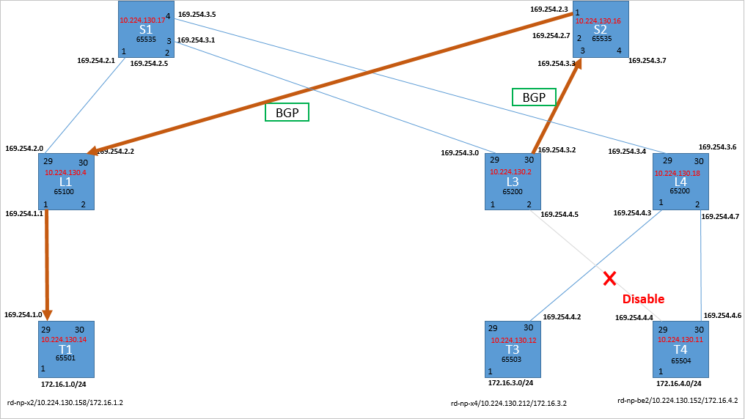
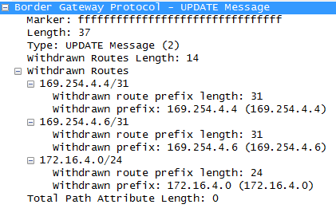
BGP UPDATE message

Slide 11
Some calculations about PFC deadlock
It may take BGP only a few milliseconds to delete all the routes to the failure switch.
Time to create a k-hop PFC deadlock = t_{PFC*}k/B.
let t_{PFC} = 25KB, k = 4, B = 40Gbps, the time would be
25KB*4/40Gbps = 20us << 1ms

Slide 12
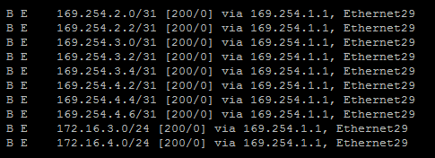
BGP study: route aggregation
169.254.0.0/16 -> Eth29
172.16.0.0/16 -> Eth29

Slide 13
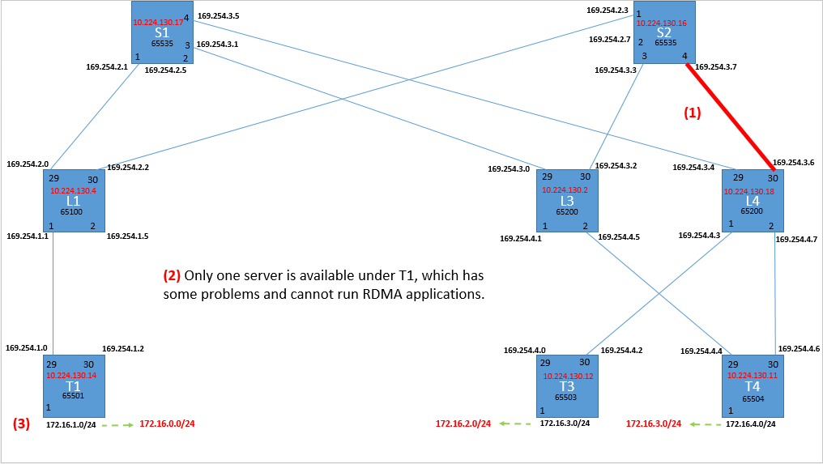
Minimum testbed requirement

Slide 14
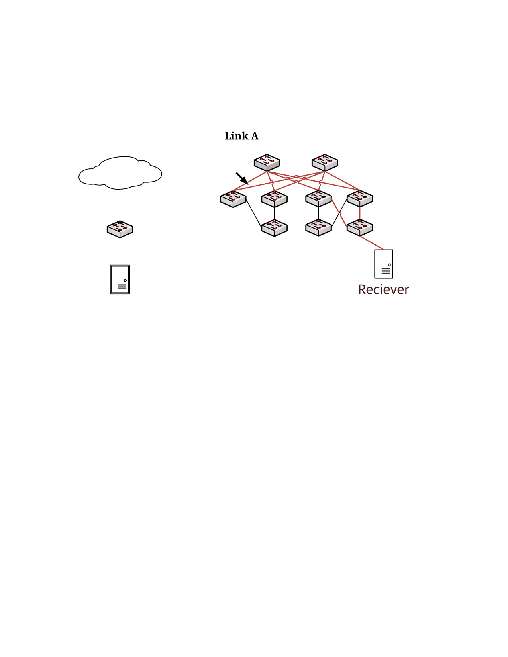

Backup: PFC deadlock case
S 1
S 2
10.0.0.0/16 -> L1
10.1.0.0/16 -> L3, L4
10.1.1.0/24 -> T4
Default -> S1, S2
L1
L3
L4
T1
T4
H1: 10.0.0.1
H2: 10.1.1.1

